Slide 1
Disruptive Technology
Team TRON
Soehl KnKade, Madison Majeed, Edward Philon, Kumar Saurabh, Lyle Sherman, Ayesha Syed

Slide 2

What is Disruptive Technology?
Technology is disruptive if it inhibits
the ideal performance of a user,
regardless if in use by that user.
Also considered disruptive if newer
technology is replacing a former,
regardless of value.
Disruption ranges from disabling user
comprehension through to sensory
overload of information/tasks.
Figure 1.

Slide 3

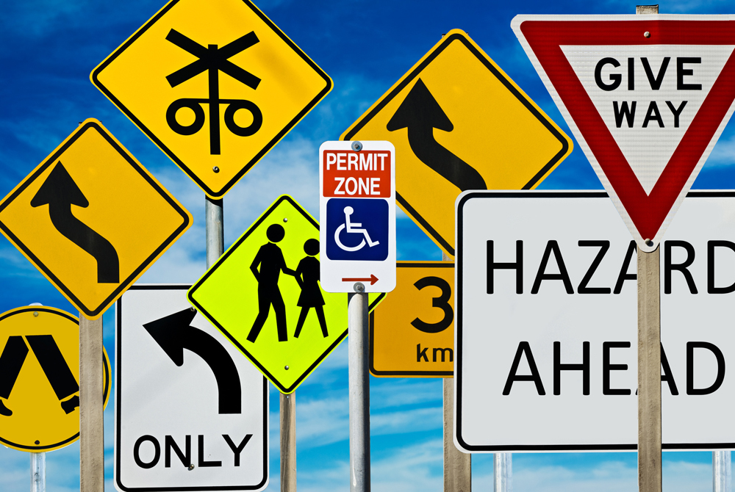
Distraction ⇔ Disruptive Technology
Current day-to-day technology use includes much more sensory stimuli than just
decades ago in order just to be able to use the new technology.
Figure 2.
Figure 3.

Slide 4
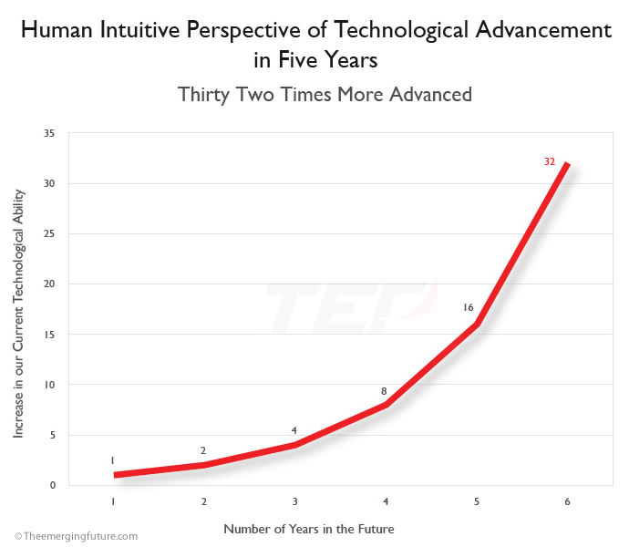
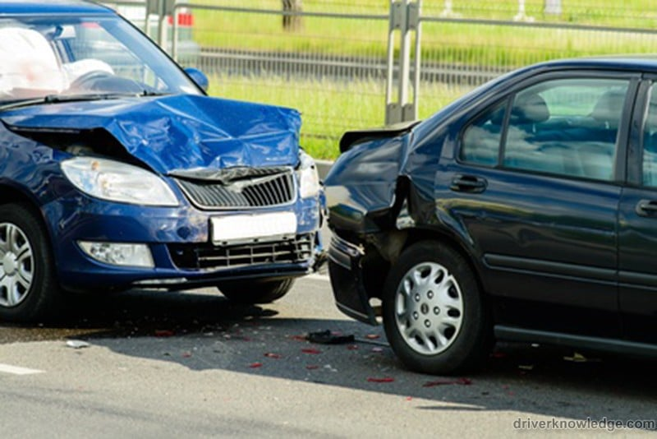
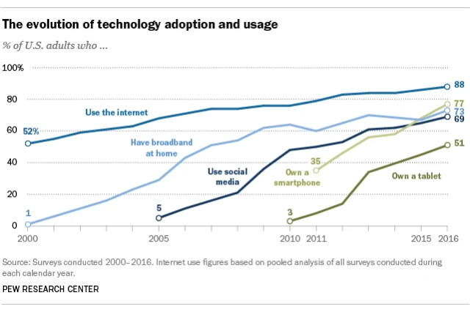
Detrimental Distraction: Tech Use Rising
Distraction is the 2nd most common cause of accidents.
90% of accidents from human error.
(Mobility Life Balance 2020)
Figure 6.
Figure 4.
Figure 5.

Slide 5
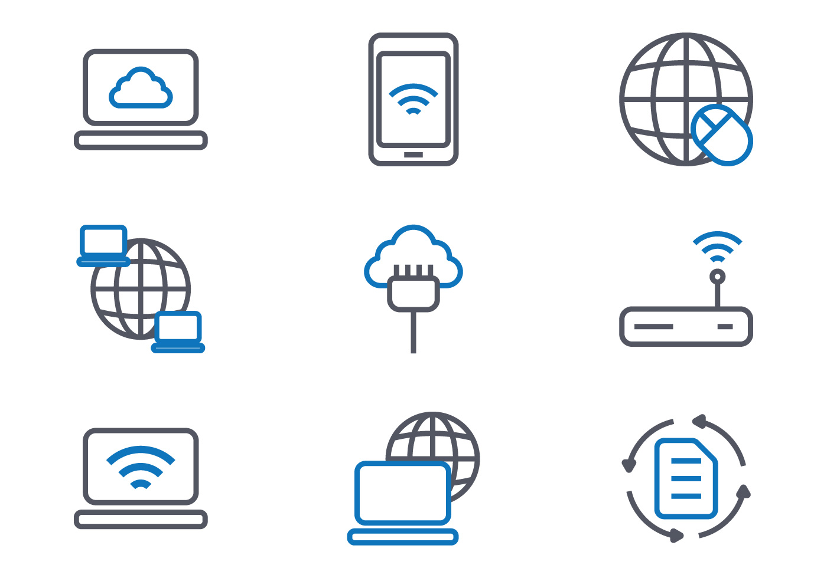
Past Disruptive Technology - Internet
Internet
First established by Advanced Research Projects Agency
Initial purpose → strategic communication network for university students
Only 5,000 users
Current status → global phenomenon due to lack of isolation, inexpensive cost, and easy access
40 million users

Slide 6
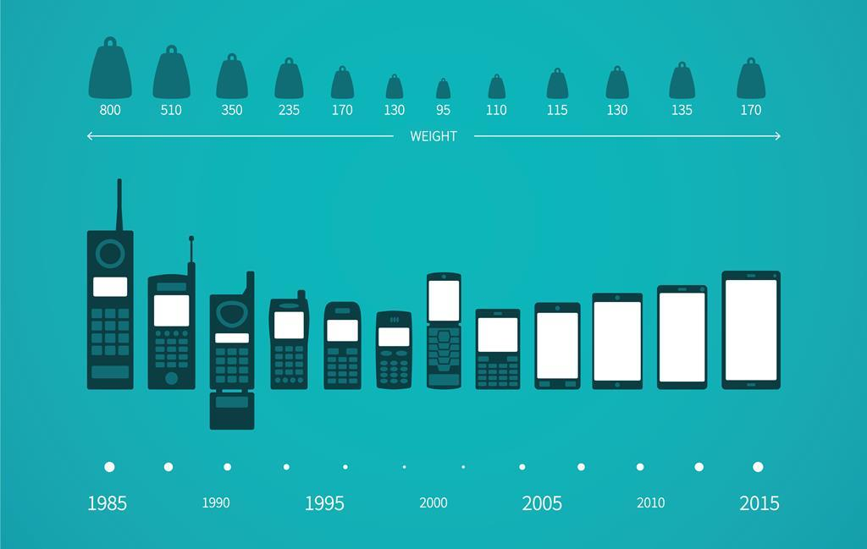
Past Disruptive Technology - Smartphones
Smartphones
IBM created first archaic version in mid-1900s
Low sales due to price and lack of awareness
3.5 billion smartphone users today due to:
Better communication, wireless internet, camera feature, unlimited apps, social media, GPS, etc.

Slide 7

Current Disruptive Technology - Voice AI
Voice AI is primarily used today for starting phone calls, answering messages, setting reminders and scheduling events
Figure 7.

Slide 8

Current Disruptive Technology - Voice AI
Voice AI’s and digital assistants are among the most disruptive technologies for enterprises today potentially erasing the need of personal assistants
Figure 8.

Slide 9
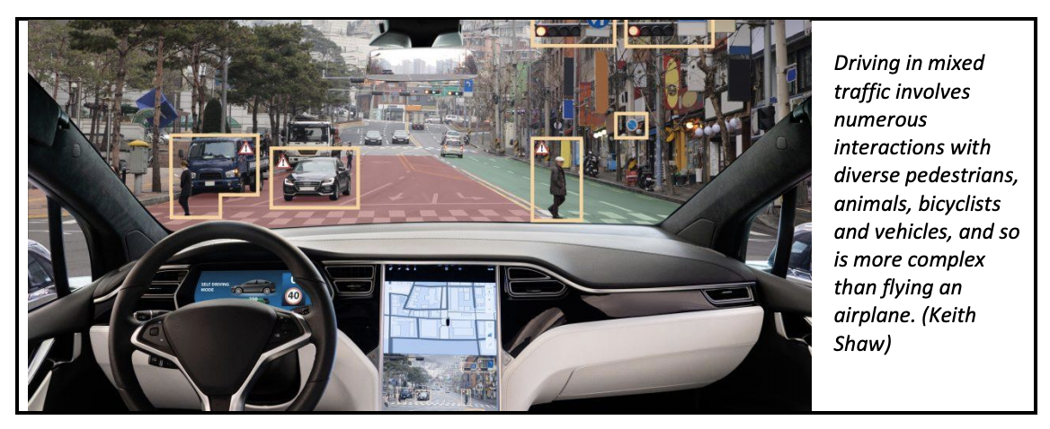
Current Disruptive Technology - Autonomous Vehicles
The autonomous vehicle technology that is equipping self-driving cars, is quickly developing and reaching maturity
(Litman 2020).
Figure 9.

Slide 10
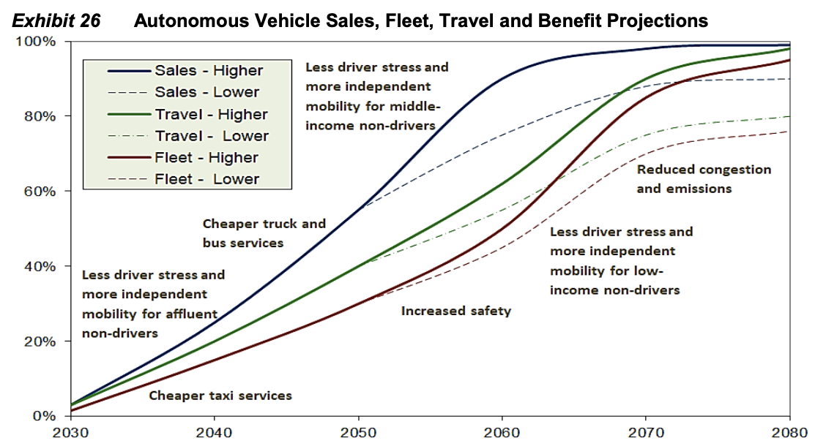
Current Disruptive Technology - Autonomous Vehicles
Concerns have surfaced regarding what public policies can minimize the problems and maximize the benefits of these new technologies that will bring self-driving vehicles to our streets and roadways. (Litman 2020)
Figure 10.

Slide 11
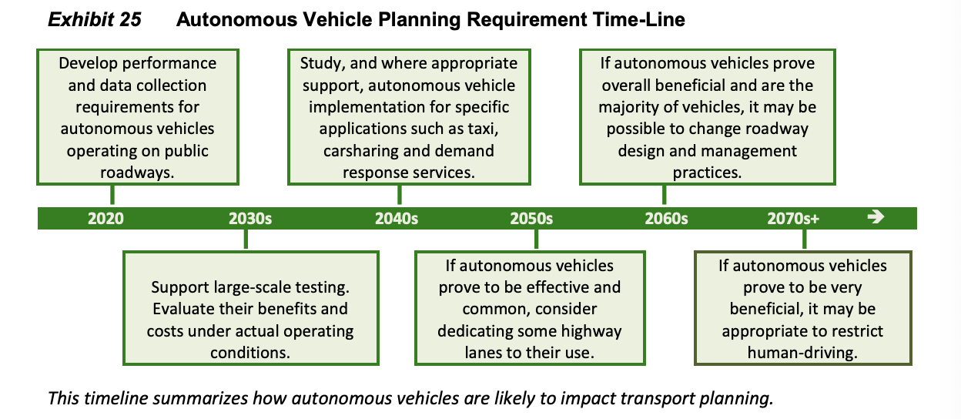
Current Disruptive Technology - Autonomous Vehicles
Many experts predict that by 2030, autonomous vehicles will be both reliable and affordable and will be so common that they will displace most human driving. This will lead to city and government planning officials taking the rise autonomous vehicles into account. (Litman 2020)

Slide 12
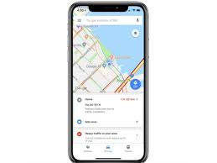


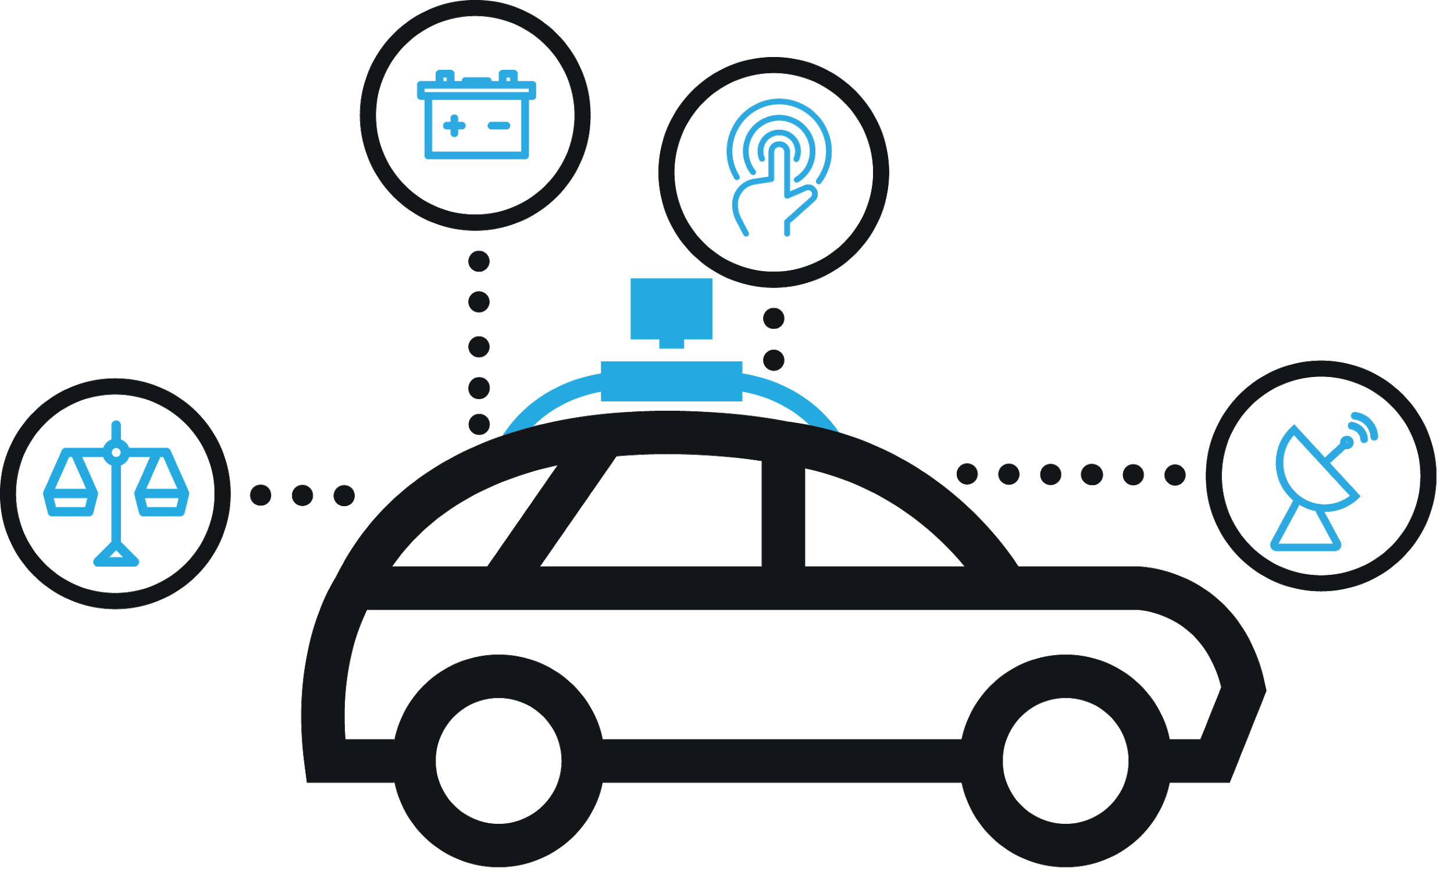


Futuristic Idea: Self Driving Taxi with Bitcoin Payment
App Features
Overview
Efficient transportation
Decrease human errors
Better road safety
Bitcoin enables users more discretion
Eliminate hidden banking fees
More Secure
Mobile app prototype will enable customers to request for self-driving taxi rides using virtual assistance and make the payment using bitcoin.
Backend Process
Bitcoin Wallet
Bitcoin Gateway

Slide 13
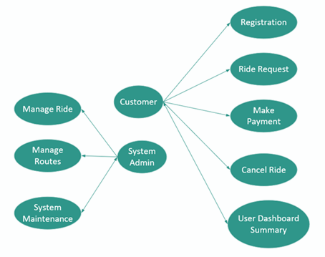
Proposed App Use case
Use Case Diagram
Actor and Role
Customer
Customer
Customer
System Admin
Registration
Ride Booking
Make Payment
Cancel Ride
User Dashboard Summary
Manage Ride
Manage Routes
System Maintenance

Slide 14
User’s Ride Request: Illustration
Pre Condition
User must be registered to App and should have Bitcoin Wallet
Voice Command
User gives voice command through App
DB Processing
A query will be fired to the database
Results
User receive list of available rides their mobile device
Receipt
System complete the transaction and user receive the receipt
Payment
System and user complete the payment with Bitcoin wallet
Order fulfillment
The vehicle software communicate with mobile device for ride request
Rides Selection
A selection will be made by the user to accept/decline ride

Slide 15
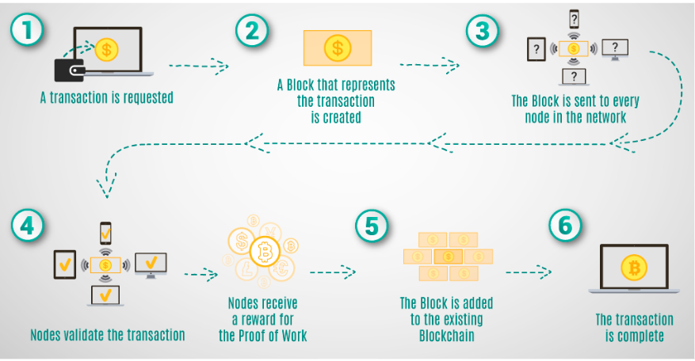
Payment Flow Using Bitcoin

Slide 16
References
Figure 1. Legris, M. (2016, March 25). Sensory Marketing & Atmosphere Of A Point Of Sale. Retrieved from
www.spotpink.com/2016/03/25/marketing-sensoriel-ambiance-lieu-vente/
Figure 2. Reviews.io (2018, May 03). Technology Overload? Not On Our Watch. Retrieved from blog.reviews.io/technology-overload-not-on-our-watch
Figure 3. Private Fleet (2013, June 18). Information Overload! Retrieved from www.privatefleet.com.au/blog/home/information-overload/
Mobility Life Balance (2020). Feeling Overwhelmed. Retrieved from www.zf.com/site/mobilitylifebalance/en/ueberforderung/feeling_overwhelmed.html
Figure 4. Driver Knowledge (2018, June 28). The Most Common Causes of Car Accidents. Retrieved from www.driverknowledge.com/causes-of-car-accidents/
Figure 5. Smith, A. (2017, January 12). Record shares of Americans now own smartphones, have home broadband. Retrieved from
www.pewresearch.org/fact-tank/2017/01/12/evolution-of-technology/
Figure 6. The Emerging Future (2012). Estimating the Speed of Exponential Technological Advancement. Retrieved from
theemergingfuture.com/docs/Speed-Technological-Advancement.pdf
Figure 7. Forbes Technology Council. (2020, January 17). 12 Ways Voice Assistants Could Boost Business Productivity. Retrieved from
www.forbes.com/sites/forbestechcouncil/2020/01/17/12-ways-voice-assistants-could-boost-business-productivity/#298c1096e966
Figure 8. Bond, S. (2019, October 22). Is voice tech set to change the way we work? Retrieved from
www.ft.com/content/8b45f858-b2f4-11e9-b2c2-1e116952691a
Litman, T. (2020, March 24). Autonomous Vehicle Implementation Predictions: Implications for Transport Planning. Figures 9 & 10. Retrieved
from www.vtpi.org/avip.pdf

